Slide 1
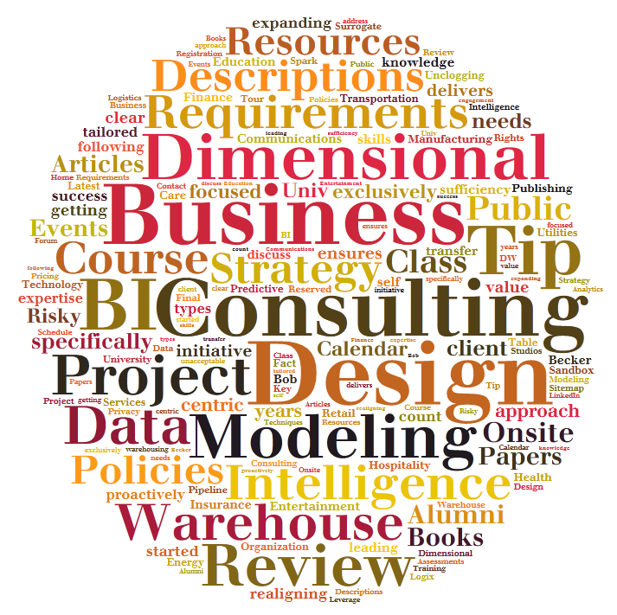
Data Warehouse
&
Business Intelligence Offering
Year 2015
Version V0.2

Slide 2
About Nippon ITS
Company Founded and Managed by Team with 10+ years Experience on Different Database and Oracle Applications Products.
We have one of best team of Experts (In house ,Freelancers and Contracts)
We follow SLAs and Security polices of customers and if not available we help building them.
Our team is highly Motivated ,Customer friendly and Passionate about their work.
We provide Services at reasonable prices and with very professional approach.
We are not “YES MAN” , we are honest , Straight forward and Even sometimes Blunt but all this is for benefits of our Customer. Our aim is to use experience to help you run your business effectively.

Slide 3
Data warehouse and BI offerings
Consulting
Implementation
Support
DW & BI Strategy
Business requirements
Dimensional Modelling
Dimensional Model Design Review
DW-Database
Development
BI and Reporting Tools
DW Management
ETL package Development
Reports Development
DW Database
Analytics Development
Changing ETL Packages
Performance issues
Manual loading of data if needed.
Monitoring

Slide 4
Readiness Assessment and Strategy Prioritization projects are appropriate both for organizations embarking on their initial data warehouse/business intelligence (DW/BI) effort and those with a mature DW/BI environment.
If this is your initial foray into DW/BI, NipponITS Team participates in the early planning stages to evaluate your organization’s readiness to launch a DW/BI initiative and develop an effective strategy.
We work with management to identify a high-priority, manageable initial scope, develop justification, and establish a roadmap for subsequent phases.
If you have a mature DW/BI environment, an assessment engagement will identify opportunities to grow and enhance your capabilities. NipponITS Team will work with your organization to evaluate your current environment, assess your methodology and strategy, and ensure your organization’s DW/BI capabilities align with the business’s strategies and requirements. The assessment analysis will identify critical gaps, needs and recommended actions.
Regardless of the maturity of your DW/BI environment, the goals and objectives for an assessment/strategy project include:
Understand the high priority business requirements ,reporting and analytic needs.
Conduct a high level review of the data and data architecture to determine its suitability for supporting the identified requirements.
Derive a roadmap based on the data realities and business priorities to assure the DW/BI environment will meet the organization’s ongoing and future reporting and analytic needs.
Assessment/strategy projects typically include the following activities:
Interview key business and IT sponsors and stakeholders.
Analyze critical business requirements, executive commitment, and fundamental technical issues.
Facilitate a management session to review findings, reach consensus on priorities, and secure commitment to a roadmap.
Recommend an overall strategy for delivering enhanced DW/BI capabilities, including overall methodology, project scope, and data architecture.
Consulting
DW & BI Strategy
Business Requirements
Dimensional Modelling
Dimensional Model Design Review

Slide 5
Aligning the data warehouse/business intelligence (DW/BI) environment with the business’s requirements is absolutely critical to a successful initiative period.
Best-of-breed tools or sophisticated designs won’t salvage a DW/BI project that fails to focus on the business.
Nippon ITS team interviews key business management and knowledge workers to understand their business objectives, analytic requirements and associated potential business impact, and project success criteria.
We conduct data discovery interviews with IT representatives knowledgeable about the key source systems to ensure that appropriate, feasible boundaries are established early in the process.
Upon completion of the interview process, Nippon ITS team assimilates and analyzes the interview results. The findings are then presented to the appropriate stakeholders to validate the results, ensure consensus on the vision, and establish future priorities.
NipponITS team’s requirements deliverable typically covers the following topics:
Critical business and analytic requirements
Feasibility of existing systems and data to support the capabilities required
Preliminary data warehouse bus architecture with common business dimensions
Initial project success criteria
Key issues/risks with tactical and strategic recommendations.
Consulting
DW & BI Strategy
Business Requirements
Dimensional Modelling
Dimensional Model Design Review

Slide 6
The goal of a data warehouse and business intelligence (DW/BI) solution is to publish the “right” data and make it easily accessible to decision-makers. Successful DW/BI implementations rest on the foundation of a dimensional model to deliver both ease-of-use and query performance.
The effective dimensional models reflect the natural performance measurements and descriptive attributes of a business. They survive reorganizations, acquisitions, and other business changes, if designed properly.
Business partners will find a well-designed dimensional model intuitive because it mirrors the way they think about the business, not the way a data modeler has normalized the organization’s data.
Dimensional models are critical to enabling the business to leverage the organization’s valuable information assets.
Nippon ITS Team often engages in a Dimensional Model Design project immediately following a Business Requirements effort.
In other cases, the client may have independently completed the requirements analysis process. Nippon ITS consultants work closely with key business liaisons and IT professionals to facilitate the design of flexible dimensional models through a series of joint design workshops.
The process results in a design specification describing the fact and dimension tables and associated columns, along with sample values, slowly changing dimension policies, and required business rules transformations, where appropriate.
The resulting logical data model is the starting point for the physical design, source to target mapping, and ETL efforts that will follow. The model will be independent of database platform and/or tool idiosyncrasies.
Consulting
DW & BI Strategy
Business Requirements
Dimensional Modelling
Dimensional Model Design Review

Slide 7
Some organizations have already invested a significant effort into gathering requirements and developing a preliminary schema, but require additional guidance before completing and implementing the model.
Typically, a Nippon ITS consultant will make a two day onsite visit.
Prior to the onsite visit, the consultant will review background documentation such as the project charter and scope, business requirements, and existing schema. In addition, we ask the client to provide a list of questions, issues and/or concerns related to the dimensional data models. During the onsite visit, the Nippon ITS consultant will facilitate discussion of the client’s modelling questions and issues and provide feedback regarding Nippon ITS’s review of the dimensional models.
While each client engagement is different, topics may include
Dimensional modelling best practices
Nippon ITS’s identified design issues
Client identified design issues
Trade-offs of alternative design options
Data warehouse architecture alternatives
Most clients take detailed notes during the onsite visit and develop written documentation summarizing the key learnings and recommendations resulting from the design review. Nippon ITS will then review and comment on this summary document. Alternately, the Nippon ITS consultant can provide a written summary for an additional fee.
A typical design review project consisting of the background materials and existing schema review, the two day onsite session, and review of the written summary document is provided for a fixed amount plus associated travel and living expenses.
Consulting
DW & BI Strategy
Business Requirements
Dimensional Modelling
Dimensional Model Design Review

Slide 8



Our Capabilities
Our Approach
Data warehouse - Database Installations
We have capability to install and configure Oracle 10g to 12C, Microsoft SQL server 2008 to 2014 for DWH
We provide high availability solutions for Databases DWH
We Provide services to implement DWH on EXADATA which provides capability to have HOT data in-memory for faster loading.
Consulting
Prerequisite checks
Implementation
DW-Database
BI and Reporting Tools
DB product Installation
Backup Strategies
Implement Backups
Monitoring Setup
Test Database
Test Backup and Restore
Documentation

Slide 9
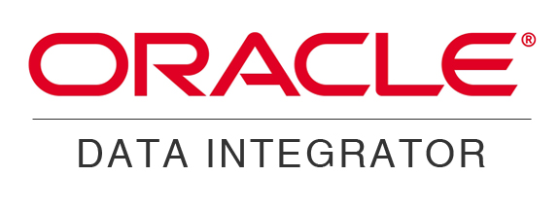


Consulting
Select best suited Tool for BI and Reporting as per client requirements.
Implementation Roadmap and Documentation.
Implementation of the BI and Reporting tools
Infrastructure setup.
Installations and Configuration.
Connectivity Tests with DWH and Other sources and DB servers.
Post implementation and configuration support for preliminary setup of the Development and deployment team.
Documentation of implementation and Configuration.
Implementation
DW-Database
BI and Reporting Tools
©Nippon IT Solutions
9

Slide 10
Developing DWH Management Scripts for
Monitoring DWH environment
Monitoring Connectivity with Connected Databases.
Design / Implement Extraction packages from different databases.
Design and Implement Customized Data Cleaning and Transformation packages.
Developing Reports Solutions
Reports can be emailed from DWH to list of users.
Providing support for External reporting system solution.
Providing Analytics development for
Complex Reports
Massaging data, Aggregating Data, Computation from data
Development
DWH Management
ETL package Development
Reports Development
Analytics Development
©Nippon IT Solutions
©Nippon IT Solutions
10
10

Slide 11
Database Administration Support
BI Tools Administration and Configuration support
Reporting server / Tools Support
Deployment Management Support
Data loading monitoring and support
Support
DW Database
Changing ETL Packages
Performance issues
Manual loading of data if needed.
Monitoring

Slide 12
DBA services
Why DBA from Nippon ITS?
Migration
And
Upgrade
24 X 7 X 365 Database Support
Performance Bottlenecks
Backup Recovery Support
Proactive Support
Storage Management
User Management
Round the clock DBA Availability
Single point of contact for each shift.
Experience and Expertise of team of DBAs at cost of 1
Providing daily / weekly reports of database issues
Solution for different Database Product under one roof.
Industry Experience / Certified DBAs
Strictly follows customer’s security guidelines
We maintain confidentiality of Customer data.
Suggesting how can we get more out of existing infrastructure.
Database
Models We Offer
Remote DBA – From Nippon ITS locations
Dedicated Services – Dedicated Team of DBA Assigned
Shared Services – A team of DBA maintaining Multiple Clients and Multiple Database.
Onsite DBA – At Client Side Dedicated DBA
On Demand – Vacation DBA – For existing customers - if they need project based ramp up or when their primary DBA is on Vacation.
Staffing Services – Provide DBA as Contract to Hire.

Slide 13

Database Administration
Why Remote DBA?
Saving in Infrastructure cost ,Recruitment , Training cost and payroll costs
Multiple Shift resources taken care by us.
SME available for inability of frontline DBAs
Multiple platforms support.
Multiple Products Support
Database
Why Dedicated DBA?
Complex Projects or Development Setups
High availability Requirements
Walking support required by Client teams
Unstable Environments
Heterogeneous Environments
Initial Implementation.
One Dedicated DBA at onsite as point of contact.

Slide 14

Implementation
Our Approach
Implementation Capabilities
Consulting
Basic Database Implementation.
Heterogeneous connected Database systems.
Golden Gate Setup for heterogeneous Environment for different Database products
Physical or logical Standby Database system for oracle database.
Real Application Clusters for Oracle Database.
Clustered MYSQL Database implementation.
Microsoft SQL Server Failover Database Implementation.
Database As Services Implementation using Oracle Engineered system and Oracle Enterprise Manager 12c
Prerequisite checks
DB product Installation
Database
Backup Strategies
Implement Backups
Monitoring Setup
Test Database
Test Backup and Restore
Documentation

Slide 15
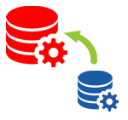

Migration and Upgrade
Our Approach
Capabilities
Consulting
Database version Upgrade
Oracle 9i to 12c
MySQL 5.x
Microsoft SQL Server 2000 to 2014
Oracle Applications Upgrade
Migrating environments to high-availability environments
Migrating database to EXADATA
Oracle Applications version Upgrades
Zero downtime upgrades and Migration.
Migration Tool Selection
Cook Book Creation
Database
Identify Data Issues
Impact Analysis present to Customer
Downtime and Impacts Approval
Implement Changes
Test The System
Update Documentation

Slide 16
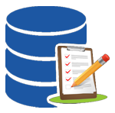
Database Assessment
Why Database Assessment
Our Approach
Installation using Default configuration
Old backup Strategy
Unused users in application database making it vulnerable.
Change in Security Policies
Evaluation of Stability of Databases
Details of Infrastructure
Past Problem History
Database Backup Strategy
Database
Current Security Policy
Operating System Checks
Capability
Database Analysis
All versions of databases for Oracle / MYSQL / MSSQL
Engineered Systems.
Traditional Infrastructure.
Document Security Issues
Recommendations
Final Signoff

Slide 17

Database Performance Tuning
Our Capability
Do I need Performance tuning?
Database Server Memory Tuning
Database Memory
Tuning
Storage Defragmentation
Operating System
Tuning
Database Query
Tuning
Cluster Replication Tuning
Backup Recovery Tuning
Is your Application Users are raising requests for timeouts?
Is your batch processes takes longer than usual.
Have you upgraded your Database?
Have you added more users and more functionalities on applications?
Have you consolidated Schemas of different applications?
Database
If answer to all these questions is YES .
You need Performance Tuning Services.

Slide 18
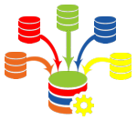
Database Consolidation – Business Drivers
Bound to have better service levels due to Standardized infrastructure
Higher up time
during patching
Faster aligning business need.
Faster provisioning
Faster / Automatic scale up and scale down
Higher Service Levels
Increased agility
Database as a service DaaS
Infrastructure as a service IaaS
Database
Cost Reduction
Reduced Complexity
Less servers
less Capital investment
Less Server Operations cost
Savings on Power
Environment friendly
Faster upgrades
Standardizing the Database operating systems.
Easy Manageability of Database infrastructure

Slide 19

Database Consolidation – Our Approach
What is objective of consolidation
Probability of successful consolidation
What is the present Infrastructure
What is present SLA ?
What is present support cost?
Present infrastructure Detail study
Specific requirements of certain application if any
Security setup for this infrastructure
Feasibility
Assessment
Database
Monitor the database growth
Optimize storage and CPU utilization on basis of real usage.
Monitor security Breech
Create Seed database for adding new database groups.
Database Grouping.
Security requirements.
Server requirements
Storage requirements.
Tool for DaaS for faster implementation and better support.
Architecture
Manage
Implementation
Implementing Storage and infrastructure
Implementing database provisioning applications
Group Database and create Seed Database for each.
Provision databases as per application needs
Migration of the Databases
Setup monitoring tools.
Test the load and fine tuning of the Database Infrastructure.
Performance monitor and changes as per requirements

Slide 20
Database Consolidation – Our Capability
Cloud Implementation
DBaaS
Schema Consolidation
Database Consolidation
Implementation and Support of database on Cloud products
Consolidation of multiple database server to one Engineered Database Infrastructure.
Faster Provisioning of database
Efficient and controlled Self service Database provisioning.
MS SQL server on Azure
Oracle Database Cloud solutions
Database on AWS Cloud
Schema consolidation Fitment Analysis
Performance and Database Parameter changes to suit consolidated schema
Schema Migrations and Consolidation Planning.
Consolidation using Oracle Database 12c
Consolidation of databases on Microsoft SQL Server
Database

Slide 21





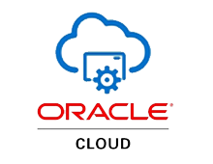
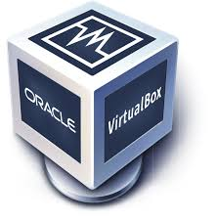





Database Infrastructure
Hardware
Capability
Cloud
Virtualization
Infrastructure Services and Consulting.
Design Database Infrastructure
Procurement Consulting.
Implementation at site
Database on Cloud server Implementation and Support
Virtualization Design and Implementation and support.
Operating System Installations of Windows / Linux .
Database

Slide 22
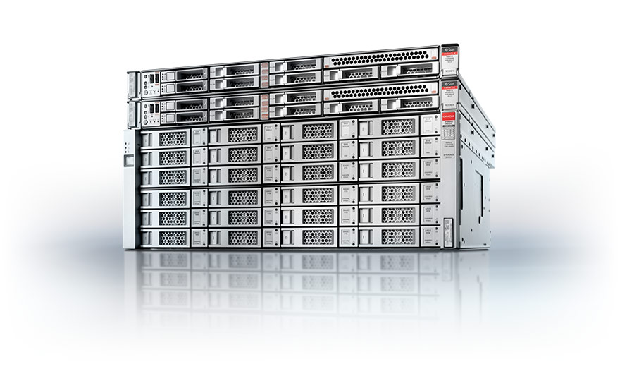

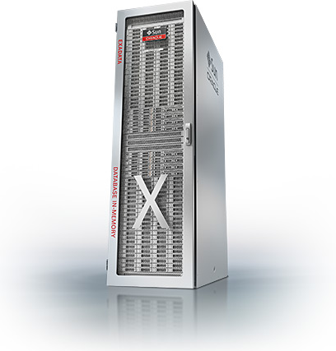
Oracle Engineered Systems
Consulting
Installation & Configuration
Migration Services
Tuning & Value Add Services
Engineered system Fitment
Migration Process and Documentation
Database as a service implementation
High Availability
Feasibility Study
Implementation Plans and Roadmaps.
Exadata Machine Configuration
Backup strategy Implementation
Non Oracle / oracle to Exadata Migration
Oracle EBS on Exadata
Zero downtime migration using Golden Gate
Database and application performance tuning after implementation
Database

Slide 23

Database Designing
Our Approach
Database Modelling Tools
ERWIN
PowerDesigner by SYBASE
MySQL Workbench
Microsoft SQL Management Studio
SQL Developer
Microsoft Visio
Discussion with Functional Teams
Support during development
Documentation and Final Delivery of model
Requirement Document Analysis
Discussion with Technical Team - Frameworks and Technology
Creating Logical / Functional Model
Creation of Physical model
Creation of Scripts
Database

Slide 25








Customer Relationship Management
Service Management
Financial Management
Human Capital Management
Project Portfolio Management
Advance Procurement
Supply Chain Management
Consulting
Designing
Implementation
Development
Global Rollouts
Remote and Onsite Technical Support
Oracle Applications

Slide 26
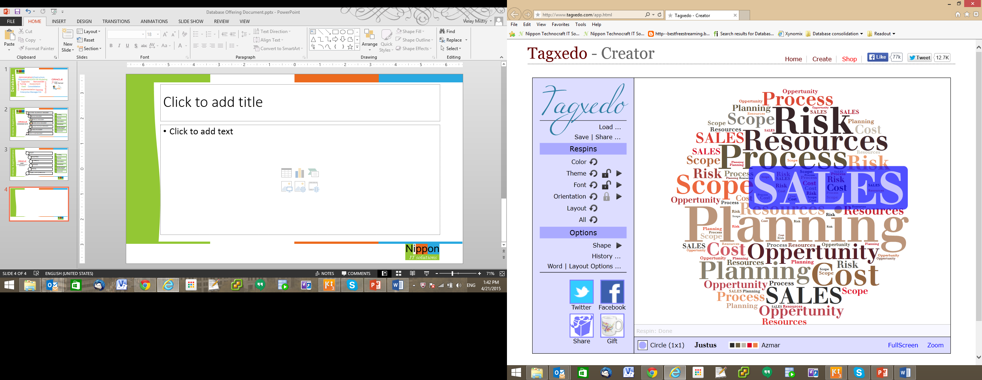
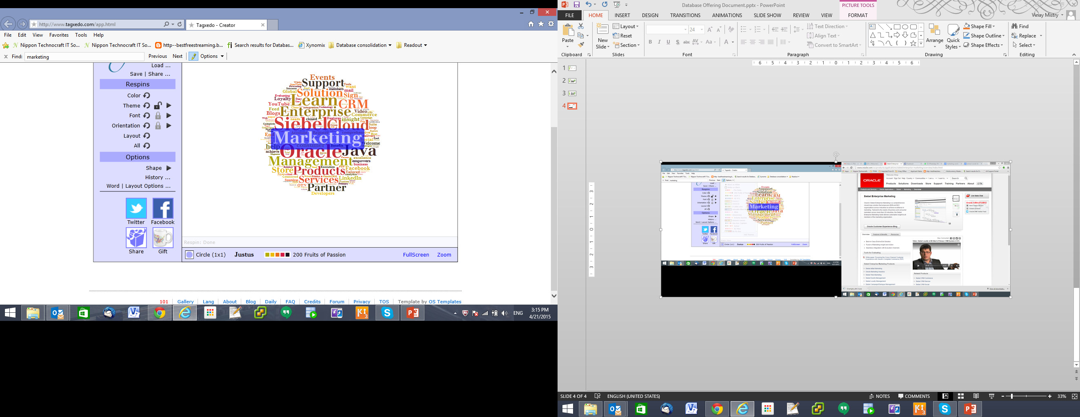
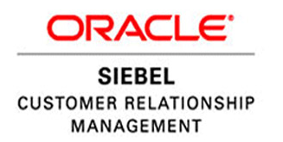
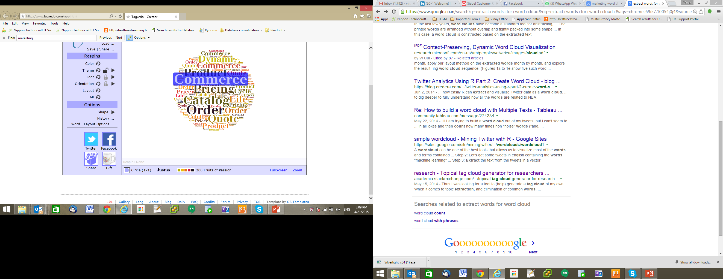
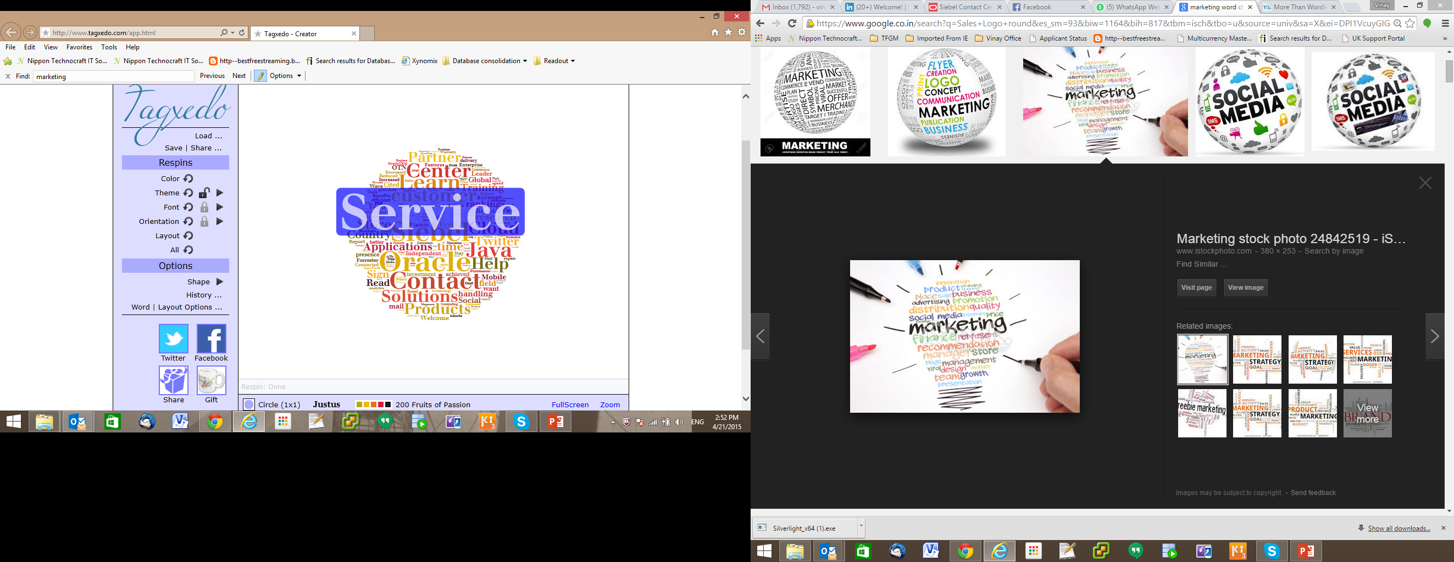
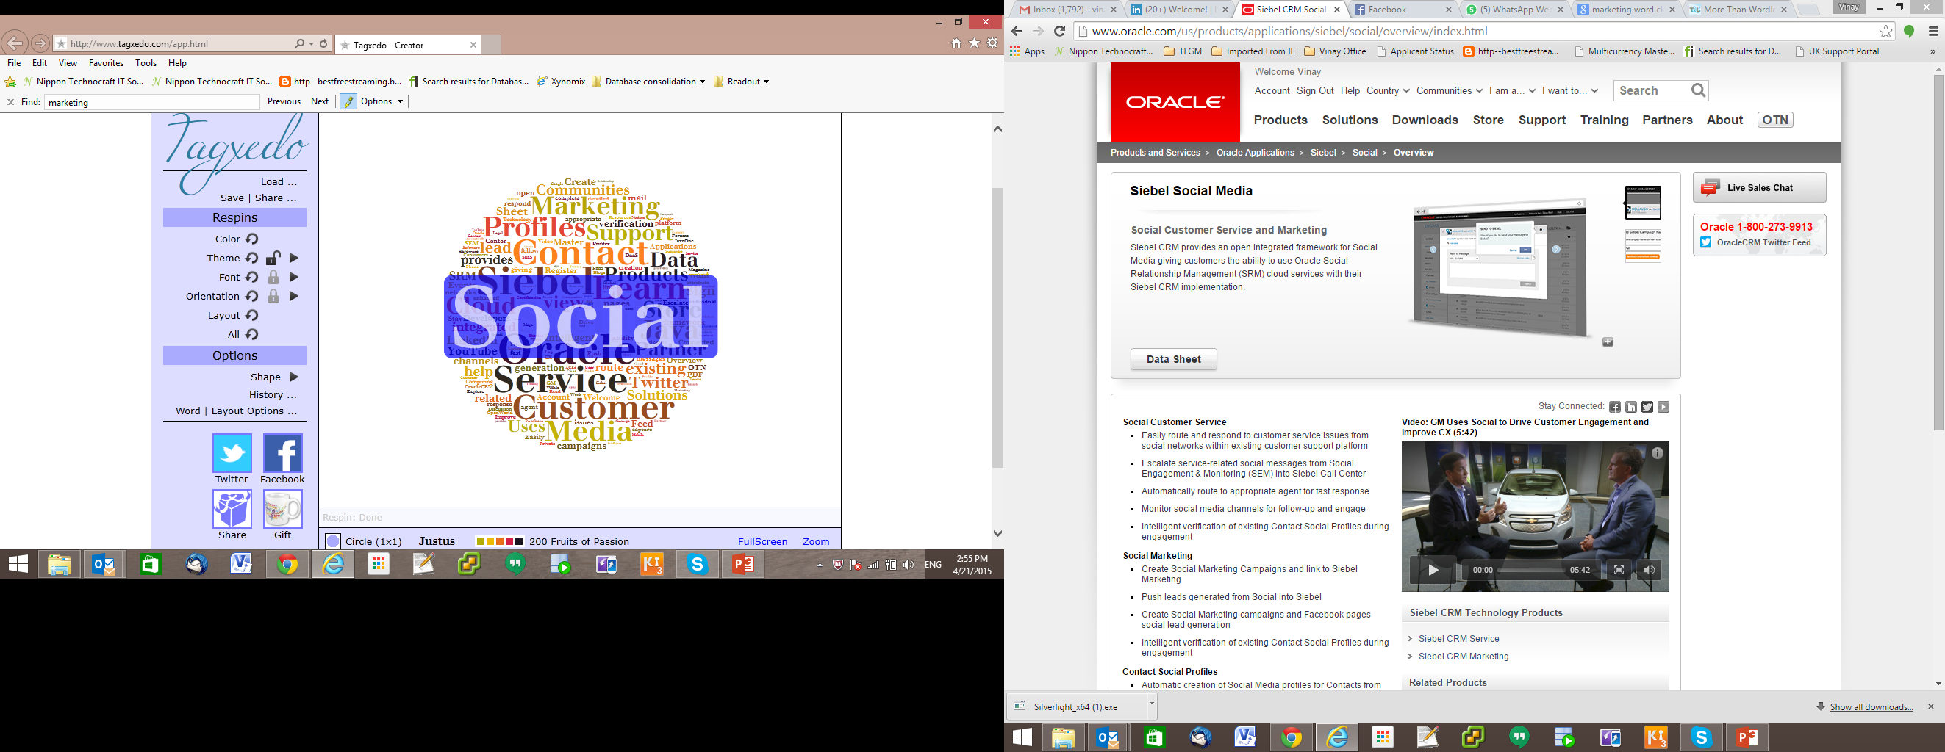
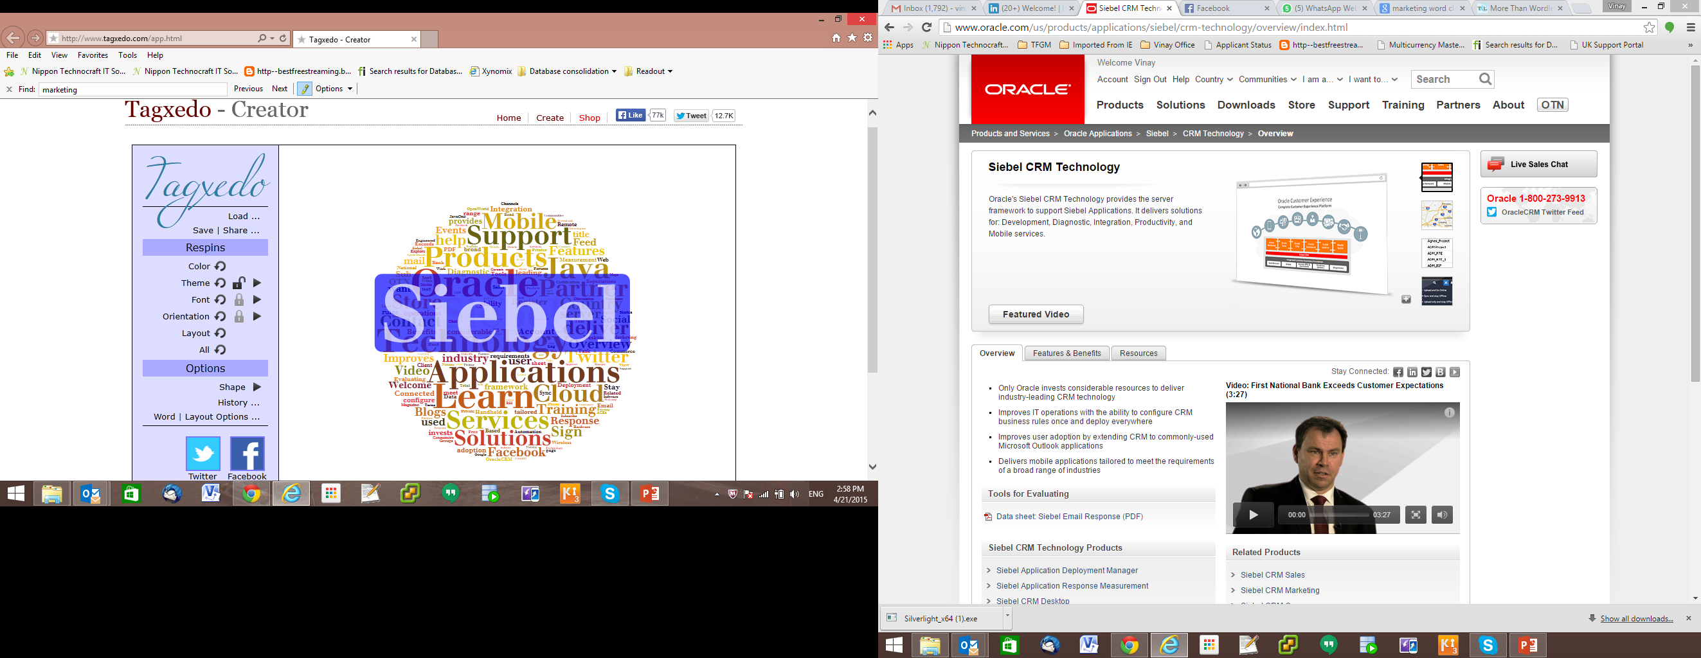
Sales
Marketing
Commerce
Service
Social
Siebel CRM Technology
Consulting
Remote and Onsite Technical Support
Designing
Implementation
Development
Global Rollouts
Oracle Applications

